Slide 1

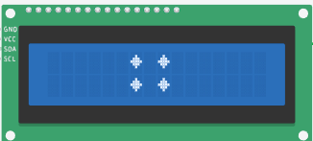
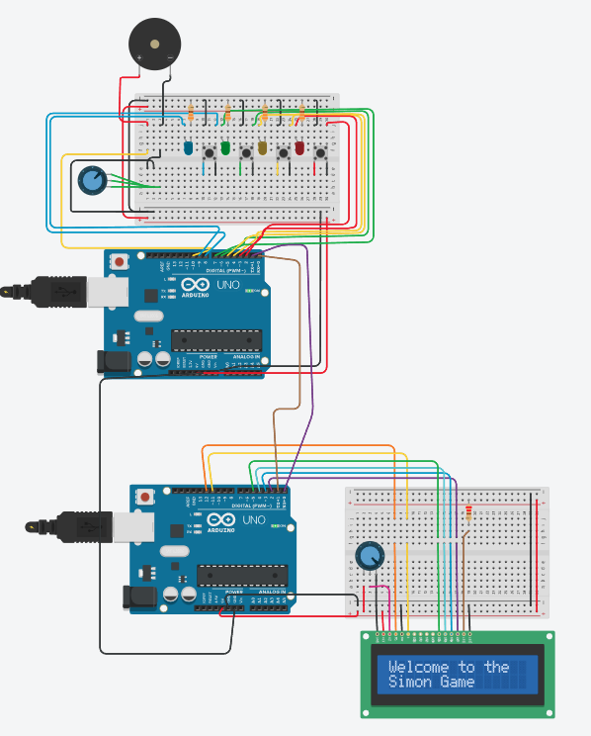
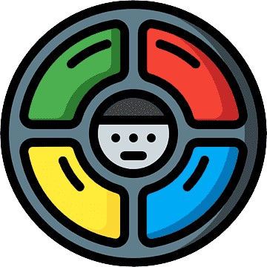







Embedded Software Development | Simon (game) Matan Katsnelson , Bar Harush , Tomer Edelsberg Computer Science , 3rd year , semester B - (2023-2024) מדעי המחשב , שנה שלישית , סמסטר ב – (תשפ"ד)
Vladi Bodnitsky
Introducing Simon (game) –
Our project, Simon Says, is a take on the classic memory game. This game is built using two Arduino boards: one to handle the game logic, buttons, LEDs, and buzzer, and the other to manage the display on an LCD screen. The project demonstrates our understanding of embedded systems by integrating sensors and serial communication between microcontrollers.
The goal of Simon Says is to test and improve the player’s memory through increasingly complex sequences of lights and sounds. Each round challenges the player to repeat a growing sequence of button presses, with feedback provided through visual and auditory cues. The game is won by successfully completing a predefined number of rounds, making it both entertaining and engaging.
Check out some of our Simon game screenshots:
In conclusion:
The development of Simon Says involved significant learning and problem-solving. We followed the SparkFun Inventor's Kit Experiment Guide for guidance, which provided a structured approach to building the game. The guide helped us understand how to connect the hardware components and write the necessary code for both the game logic, From there we took the additional integration with another Arduino R3 which was responsible for output to the screen, in that it received information from the first Arduino responsible for the game's logic.
Implementing serial communication between the two Arduinos required careful consideration of timing and data handling to ensure smooth gameplay. Challenges included synchronizing the game logic with visual and auditory feedback and managing the flow of data between the boards
Looking ahead, we see potential for adding features such as multiplayer modes or integrating the game with IoT platforms to track scores globally. Simon Says is more than just a game it's a demonstration of our vision to combine fun with technology in creative ways.
You win?
No
Loop level ++
Yes
Technologies Utilized:
Throughout the development of Simon Says, we delved into a range of embedded systems technologies. We applied bitwise and logical operators, configured DDR and PORT registers for precise control over I/O pins, and implemented debouncing techniques to ensure reliable button inputs. Additionally, we explored polling mechanisms, converted analog signals to digital using ADC, and studied UART communication protocols for seamless serial data exchange between the Arduino boards. By referring to datasheets and employing directives, we ensured that our implementation adhered to best practices in embedded systems design
Use this QR code for to review our project in GitHub:
Scan the QR code for a demo video:

